Slide 1
Inferring Binding Site Motifs from HT-SELEX Data
ACGT group meeting 8/5/13
Yaron Orenstein

Slide 2
Talk Layout
Background
Previous work on HT-SELEX technology.
Our analysis
Our analysis of the new HT-SELEX data.
Summary
Including future plans.

Slide 3
BACKGROUND

Slide 4
Biological Introduction
Transcription is regulated mainly by transcription factors (TFs) - proteins that bind to DNA subsequences, called binding sites (BSs).
TFBSs are located mainly in the gene’s promoter – the DNA sequence upstream the gene’s transcription start site (TSS).
TFs can promote or repress transcription.

Slide 5
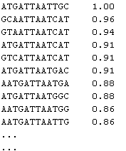
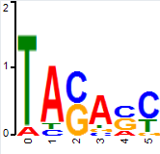
Binding Models
Affinity table Position weight matrix
6 | 5 | 4 | 3 | 2 | 1
0 | 0.2 | 0.7 | 0 | 0.8 | 0.1 | A
0.6 | 0.4 | 0.1 | 0.5 | 0.1 | 0 | C
0.1 | 0.4 | 0.1 | 0.5 | 0 | 0 | G
0.3 | 0 | 0.1 | 0 | 0.1 | 0.9 | T

Slide 6
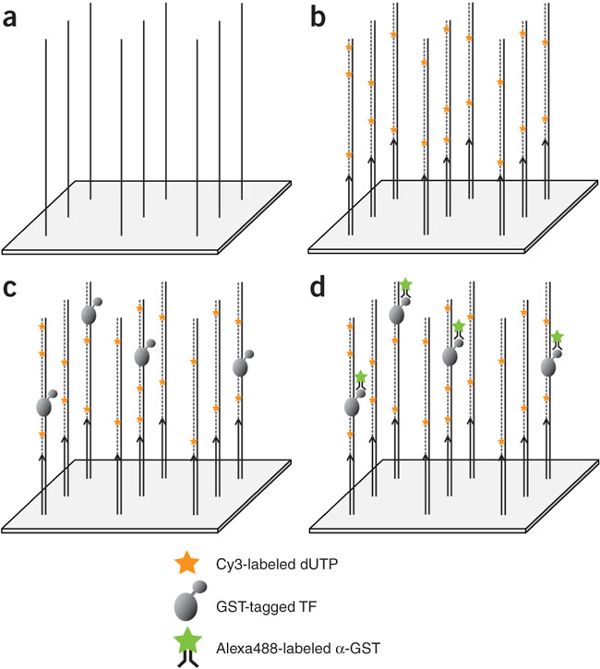
Protein binding microarrays
(Berger et al. 06)

Slide 7
Limitations of PBMs
Needs high amounts of purified proteins.
High cost.
Position effects.
Limited number of sequences on the array.

Slide 8
HT-SELEX
First introduced in:
Jolma, A., Kivioja, T., Toivonen, J., Cheng, L., Wei, G.-H., Enge, M., Taipale, M.,Vaquerizas, J. M., Yan, J., Sillanpää, M. J., Bonke, M., Palin, K., Talukder, S., Hughes, T. R., Luscombe, N. M., Ukkonen, E., and Taipale, J.
Multiplexed Massively Parallel SELEX for Characterization of Human Transcription Factor Binding Specificities
Genome Res. 20:861–873, 2010.
Taipale lab, University of Helsinki
Ukkonen lab, University of Helsinki

Slide 9
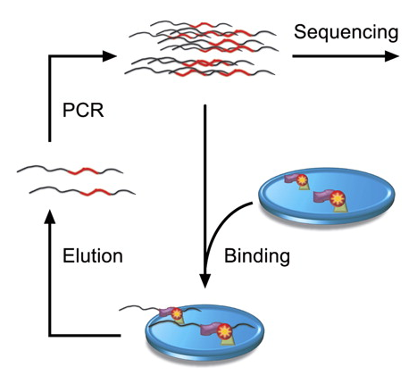
HT-SELEX

Slide 10
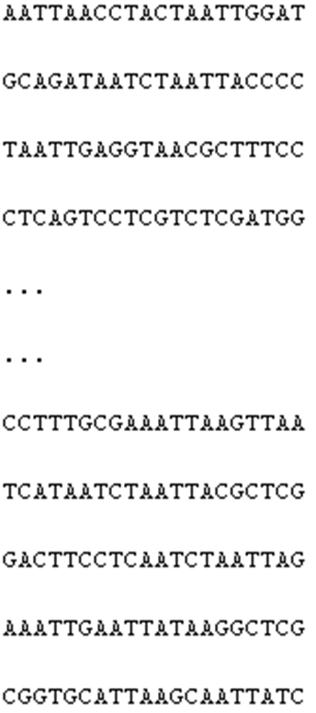
Output: Sequence File per Cycle
Around 200,000 sequences per file
Cycle 0
Cycle 2
Cycle 4
Cycle 1
Cycle 3

Slide 11
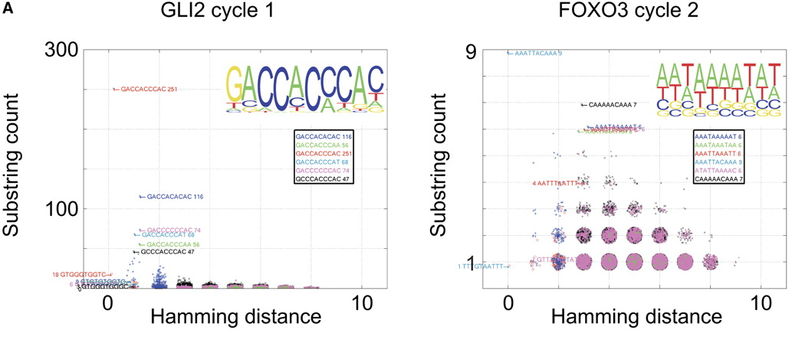
Bioinformatic Quality Control (1/3)
For 5-11 - identify the most enriched k-mer.
Plot the incidence of all k-mers as a function of the hamming distance.

Slide 12
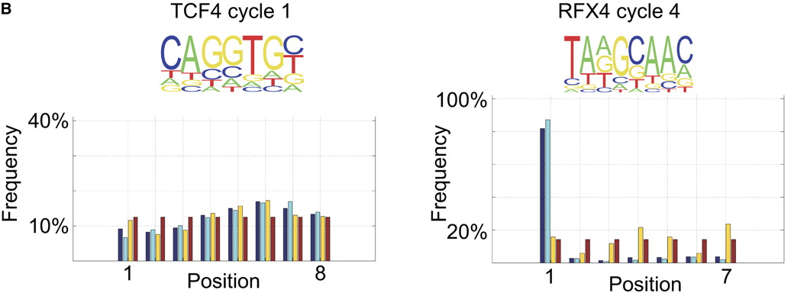
Bioinformatic Quality Control (2/3)
Frequency of the top k-mer at each position.
Forward (light blue), reverse (yellow), both (blue), control (red).

Slide 13
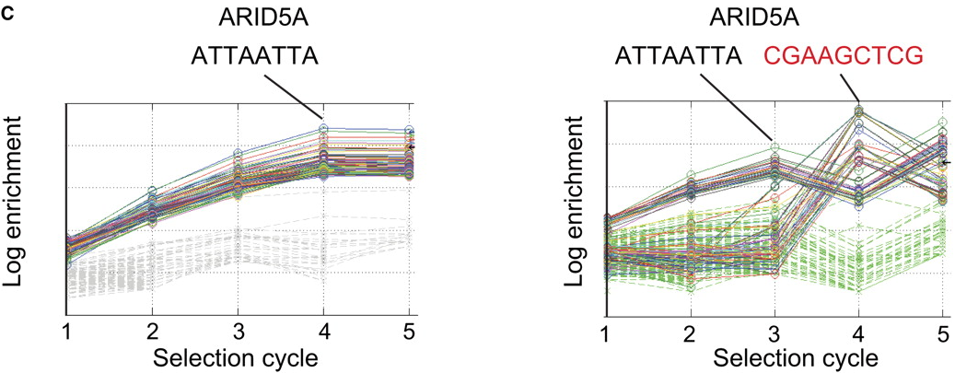
Bioinformatic Quality Control (3/3)
Enrichment of random and top k-mers.
Right figure is probably due to contamination from an adjacent plate.

Slide 14
Generation of Binding Models
Generate 5-12-long PWMs using k-mers W, for which d_{H}(S, W) ≤ 1, where S is the consensus.
Correct for non-specific carryover.
Select PWM that was derived from at least 500 sequences (preferably, more than 3000), with highest information content.
Use earliest possible cycle (to avoid distortion caused by exponential enrichment).

Slide 15
Correction for Non-Specific Carryover
f_{k} = fraction of non-specific sequences in cycle k.
f_{k+1} = λ f_{k}
f_{k} estimated by the sum of the number of occurrences of all 8-mers that rank between 25% to 75% in relative abundance divided by the number of sequences N_{k}.
Then, for the count matrices M_{k+1} and M_{k} generated using the same consensus:
M_{corrected} = M_{k+1} – (λ N_{k+1}/N_{k}) M_{k}

Slide 16
SELEX-seq
A competing technology published in:
Slattery, M., Riley, T., Liu, P., Abe, N., Gomez-Alcala, P., Dror, I., Zhou, T., Rohs, R., Honig, B., Bussemaker, H.J., and Mann, R.S.
Cofactor Binding Evokes Latent Differences in DNA Binding Specificity between Hox Proteins
Cell 147:1220-1221, 2011.
Bussemaker lab, Columbia University
Mann lab, Columbia University

Slide 17
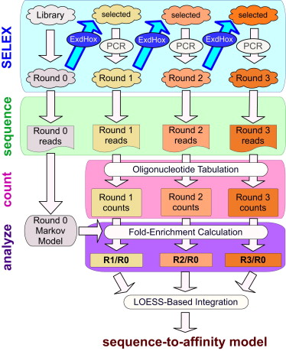
SELEX-seq Technology
Initial library is 16bp random oligos.
Filtering by electrophoretic mobility shift assays.
At least three rounds for Exd-Hox complex.

Slide 18
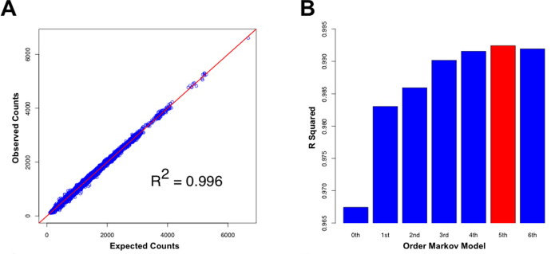
Computational Inference
Based on first rounds to avoid over-selection.
R0 modeled using a 5th-order Markov model.

Slide 19
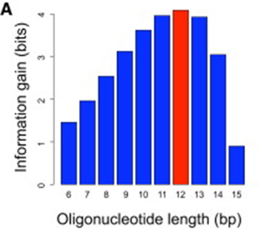
Determining the Length
For each length, calculate the information gain (Kullback-Leibler divergence of R2 relative to R0).
S₁₀₀ = all k-mers that appear at least 100 times in R2
(the rest are treated as a signle category)
P_{i}(w) = frequency of k-mer w at cycle i

Slide 20
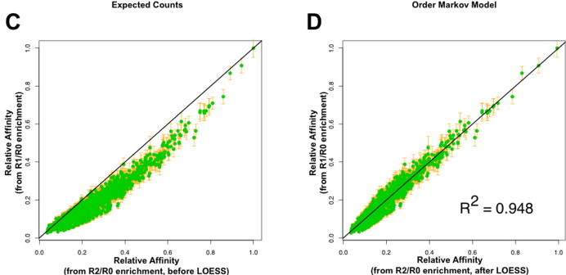
Relative Affinity Estimates
Used a LOESS-based regression to build a sequence-to-affinity table (combines higher accuracy of R1 and higher precision of R2).
The affinities computed as (Rn/R0)^{1/n} are corrected for any non-linear bias after LOESS regression on R1/R0.

Slide 21
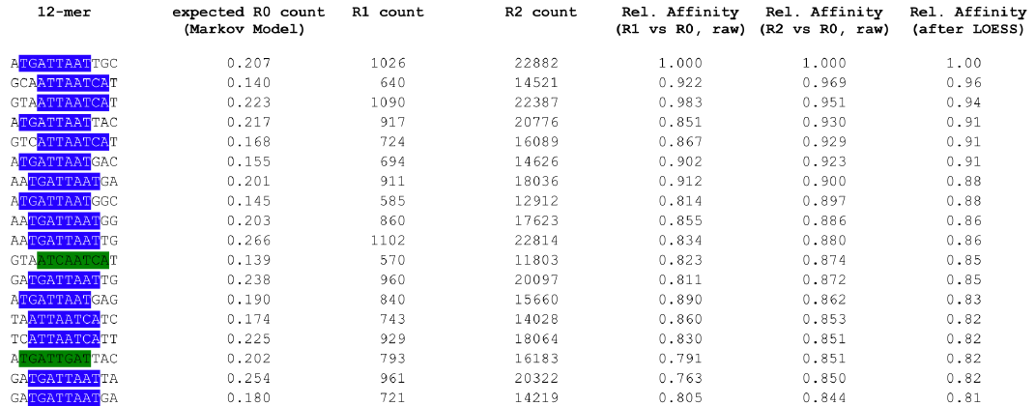
Affinity Table
R1 count is divided by that of the highest-affinity motif.
R2 count is the square root of the ratio R2/R0.

Slide 22
The New Data Sets
Published in:
Jolma, A., Yan, J., Whitington, T., Toivonen, J., Nitta, K.R., Rastas, P., Morgunova, E., Enge, M., Taipale, M., Wei, G., Palin, K., Vaquerizas, JM., Vincentelli, R., Luscombe, NM., Hughes, TR., Lemaire, P., Ukkonen, E., Kivioja, T. and Taipale, J.
DNA-Binding Specificities of Human Transcription Factors
Cell 152:327-39, 2013.
Taipale lab, University of Helsinki
Ukkonen lab, University of Helsinki

Slide 23
Genome-Scale TF-DNA-Binding Specificity Assay
Human full-length TFs | Mouse DBDs | Human DBDs
984 | 444 | 891 | Cloned
151 | 84 | 303 | Robust enrichment in
The set contains 411 different TFs.

Slide 24
OUR ANALYSIS

Slide 25
Predicting PBM binding (1/2)
We used the HT-SELEX-derived motifs (published in the Cell paper) to predict bound PBM probes.
Average AUC over 130 profiles.
PBM-derived models |  |  |  |  | HT-SELEX
AmadeusPBM | Seed-and-Wobble | RankMotif++ | BEEML-PBM | RAP | Cell paper
0.877 | 0.871 | 0.881 | 0.898 | 0.896 | 0.780

Slide 26
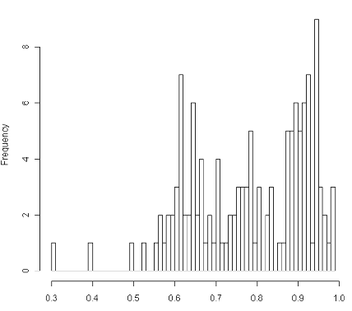
Predicting PBM binding (2/2)
In 70 profiles, results are worse by > 0.05.
In 21 profiles, results were slightly better using HT-SELEX.
Histogram of
AUC results:

Slide 27
Model-independent Comparison (1/2)
We calculated the correlation between the top 100 k-mers.
PBM k-mers scored by average binding intensity, HT-SELEX using different criteria.
Results are average correlation over 237 profiles using 100 top PBM-ranked k-mers.
cycle (i+1) / cycle (i) | cycle (i) / cycle (0) | cycle (4) / cycle (i) | Simple Counts | Squared counts
0.444 | 0.458 | 0.495 | 0.540 | 0.544

Slide 28
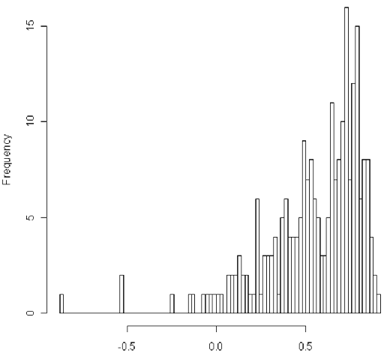
Model-independent Comparison (2/2)
Results show only partial agreement.
Histogram of
correlation
results:

Slide 29
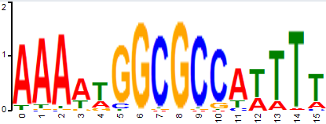
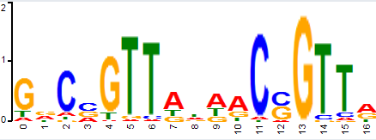
Examples of disagreement
E2F2
Mybl1

Slide 30
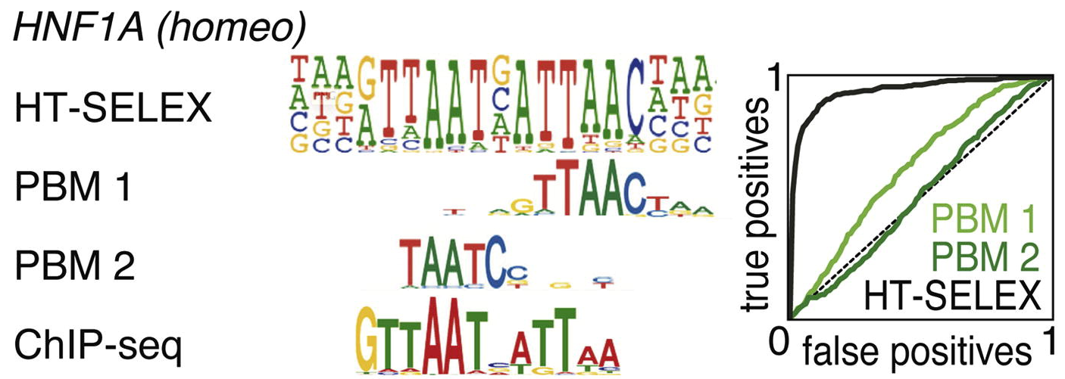
Examples from the Cell paper

Slide 31
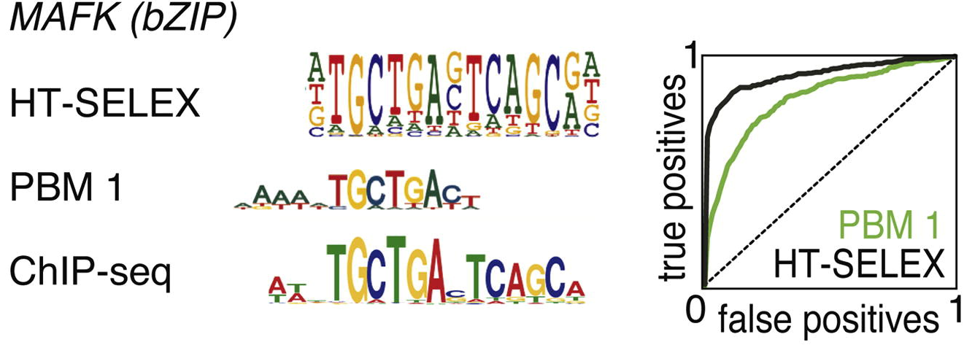
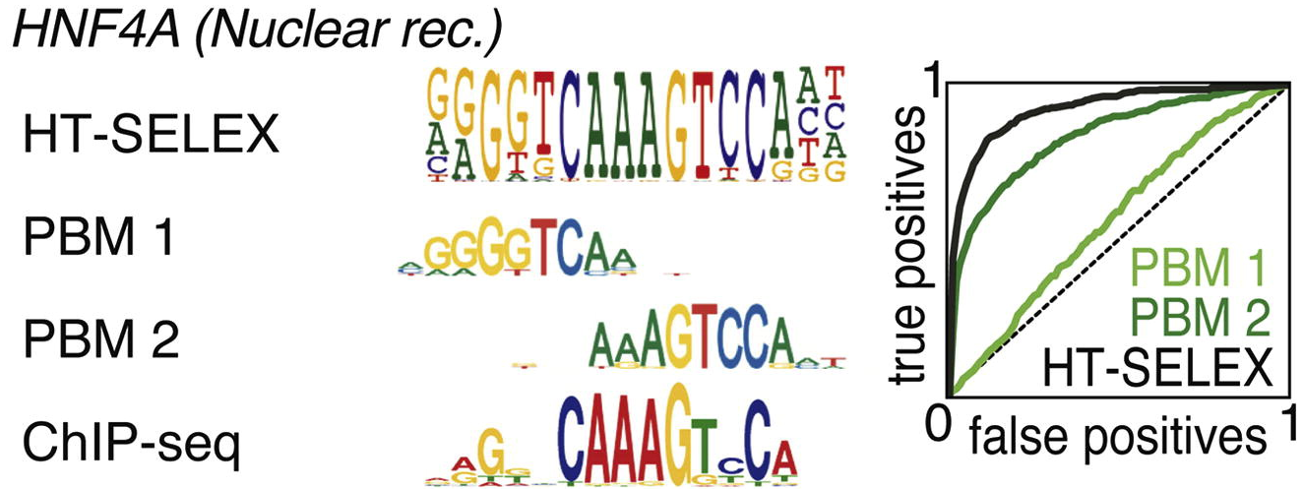

Slide 32
Attempt to Build a Model
Choose the consensus k-mer S (using different criteria: count, ratio etc.).
Build the model based on the k-mers at hamming distance ≤ 1 from S.
Corrected 4 | Corrected 3 | Cycle 4 | Cycle 3
0.744 | 0.65 | 0.745 | 0.747
K-mers 4 | K-mers 3 | Corrected matrix 4 | Corrected matrix 3
0.744 | 0.65 | 0.745 | 0.747
Average AUC over 130 PBM profiles.
HT-SELEX | PBM | Cycle 4 | Cycle 3
0.72 | 0.7 | 0.698 | 0.698
Average AUC over 63 ChIP-seq experiments (ENCODE).

Slide 33
Determining the Consensus K-mer
In about 20% of the cases, either the count or the ratio criterion fail to find the consensus.
This could be due to various biases:
Initial pool of oligos (not uniform).
Filtering bound segments by washing.
Amplification by PCR .
High-throughput sequencing.

Slide 34
An Example for a False Consensus 1
TF: Prop1
HT-SELEX seed: TAATYNAATTA
PBM seed: TTAATTAA
Count seed: CCCCCCCC
Ratio seed: AATTCAAT
Cycle | K-mer | Count |  | K-mer | One Ham Count |  | K-mer | Ratio
cycle_0 | AAAAAAAA | 36 |  | AAAAAAAA | 564
cycle_1 | CCATCGTA | 29 |  | AAAAAAAA | 264 |  | ATAGCTAT | 61
cycle_2 | CCCCCCCC | 28 |  | CCCCCCCC | 385 |  | AATTCAAT | 91
cycle_3 | AATTAAAT | 199 |  | AATTAAAT | 2741 |  | AATTCAAT | 891
cycle_4 | CCCCCCCC | 659 |  | CCCCCCCC | 6042 |  | AATTCAAT | 531
cycle_5 | CCCCCCCC | 1636 |  | CCCCCCCC | 14963 |  | AATTCAAT | 2341

Slide 35
An Example for a False Consensus 2
TF: FOXJ3
HT-SELEX seed: RTAAACAA
PBM seed: GTAAACAA
Count seed: AAAAAAAA
Ratio seed: CCCTCCCC
Cycle | K-mer | Count |  | K-mer | One Ham Count |  | K-mer | Ratio
cycle_0 | AAAAAAAA | 269 |  | AAAAAAAA | 6133
cycle_1 | AAAAAAAA | 1151 |  | AAAAAAAA | 23119 |  | CTGCGCAG | 6.365854
cycle_2 | AAAAAAAA | 767 |  | AAAAAAAA | 15822 |  | CTGCGCAG | 7.341463
cycle_3 | AAAAAAAA | 1548 |  | AAAAAAAA | 29216 |  | CCCTTCCC | 11.5364
cycle_4 | AAAAAAAA | 965 |  | AAAAAAAA | 16650 |  | CCCTCCCC | 8.777778

Slide 36
An Example for a False Consensus 3
TF: TCF7
HT-SELEX seed: AAGATCAAAGG
PBM seed: AGATCAAAG
Count seed: CCCACCCA
Ratio seed: ACGGGGCG
Cycle | K-mer | Count |  | K-mer | One Ham Count |  | K-mer | Ratio
cycle_0 | CCCCCCAA | 17 |  | CCACCCCC | 344
cycle_1 | CCCCACCC | 580 |  | CCCCCCCC | 13018 |  | AGGTTGTG | 1931
cycle_2 | CCCCACCC | 838 |  | CCCCCCCC | 18780 |  | GTAGGGGA | 1561
cycle_3 | CCCCCCCA | 2956 |  | CCCCCCCC | 63506 |  | CGCCCGCC | 4251
cycle_4 | CCCACCCA | 4425 |  | CCCCCCCC | 79641 |  | ACGGGGCG | 21741

Slide 37
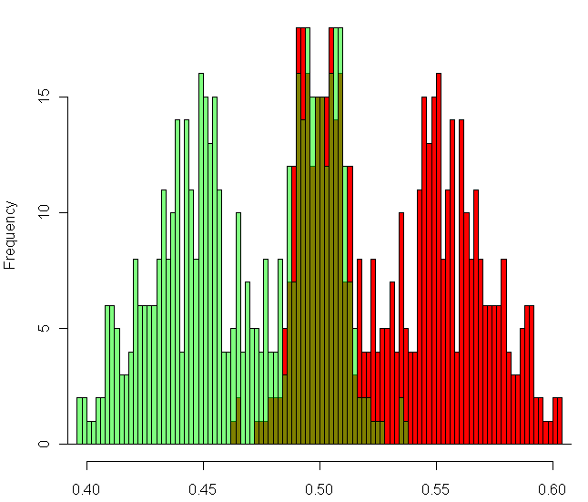
An Example for Nucleotide Bias
CG/AT distribution
in the first cycle.
CG’s are more
common.

Slide 38
SUMMARY

Slide 39
Previous Work
HT-SELEX is a new high-throughput technology to measure TF-DNA binding in vitro .
A recent study published hundreds of HT-SELEX experiments on human TFs.
Previous methods should be put to the test; we are looking for possible improvements.

Slide 40
Our Analysis
PBM and HT-SELEX agree only partially.
Attempts to build binding models reveal noisy data, possibly due to various biases.
We aim to develop a new method to overcome these biases, and highlight the real difference between the technologies.

Slide 41
Future Plans
Determine a robust criterion to find the consensus k-mer, based on several cycles.
Build a model based on different k-mers (not necessarily those that differ by one base).
Conclude which technology is better, and its disadvantages and advantages compared to the other.

